Slide 1
Hierarchical Agglomerative Cluster
HAC
https://www.datavedas.com/hierarchical-clustering/

Slide 2
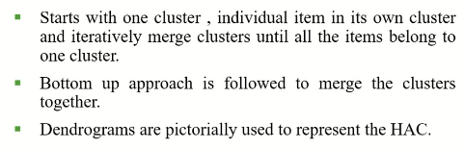
Bottom Up Clustering (HAC)

Slide 3
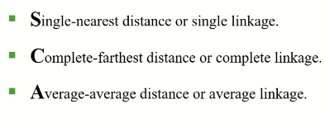
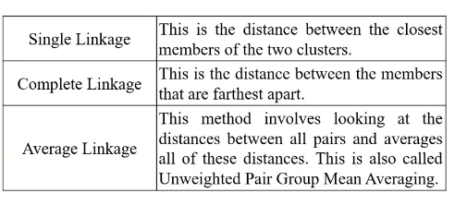
Measures of Similarity

Slide 4
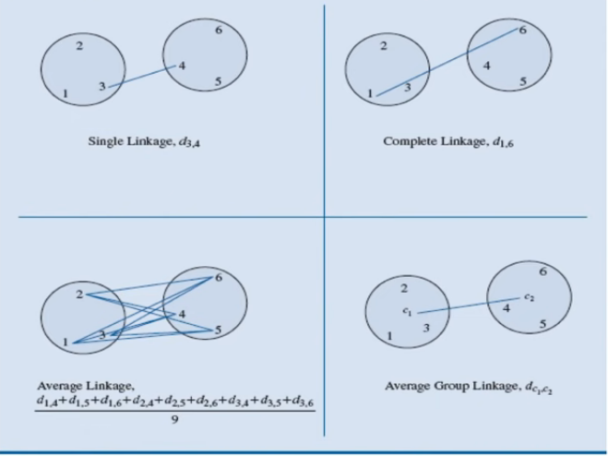
Measuring the Similarity

Slide 5
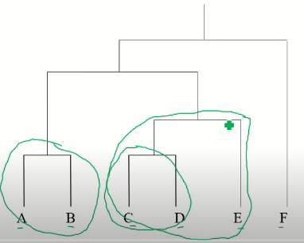
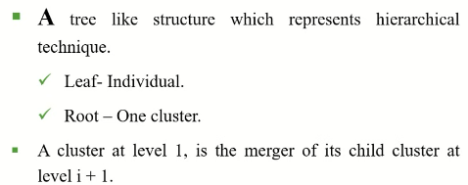

Slide 6
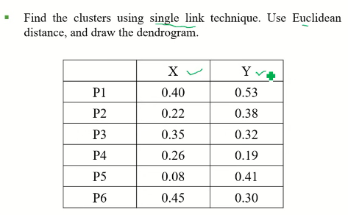

Slide 7
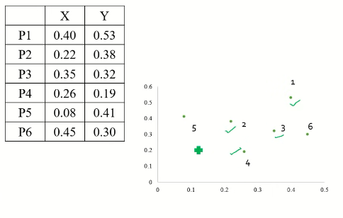






Slide 8
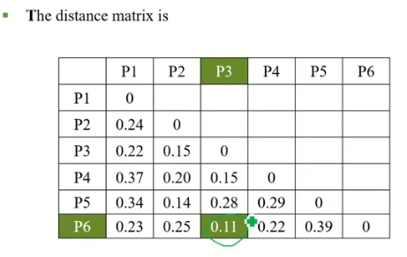

Slide 9
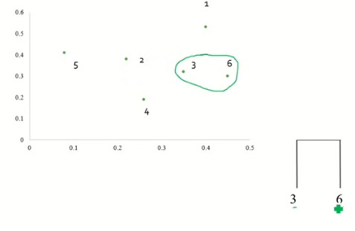

Slide 10
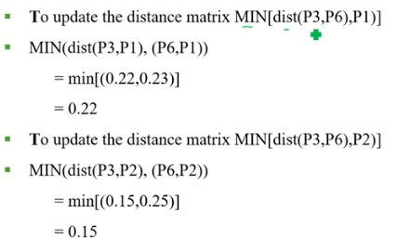

Slide 11
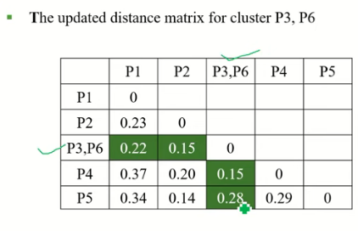

Slide 12
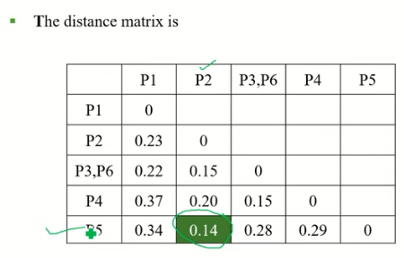

Slide 13
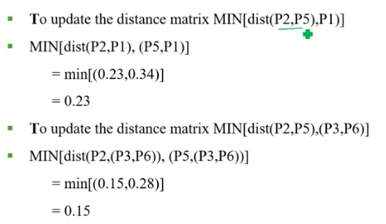

Slide 14
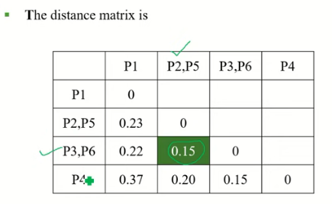

Slide 15
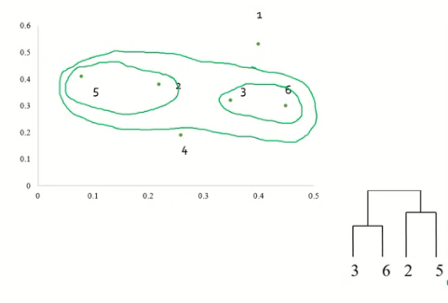

Slide 16
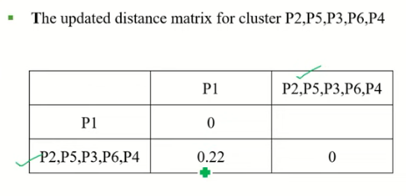

Slide 17
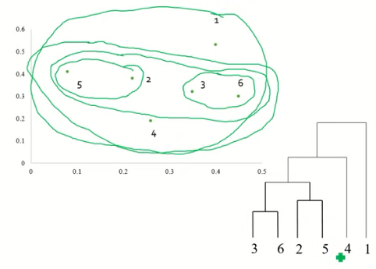

Slide 18
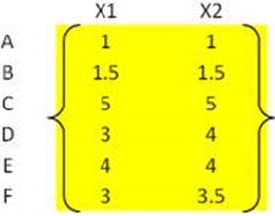
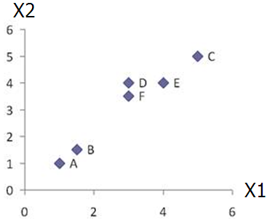
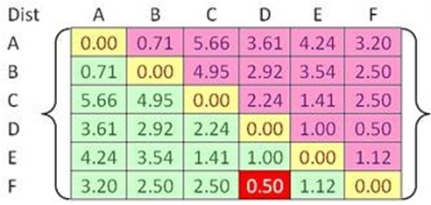


Example
Problem: clustering analysis with agglomerative algorithm
data matrix
Euclidean distance
distance matrix

Slide 19
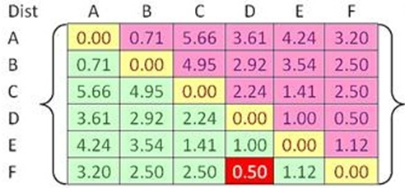
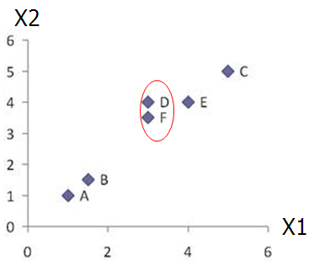
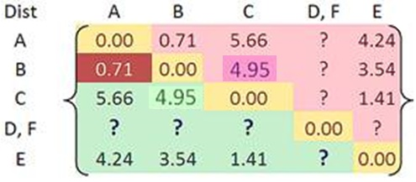

Merge two closest clusters (iteration 1)

Slide 20
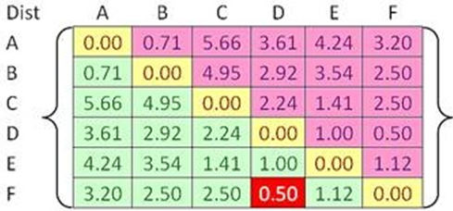

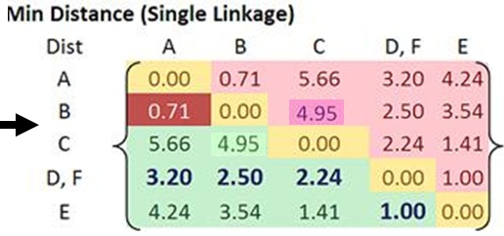
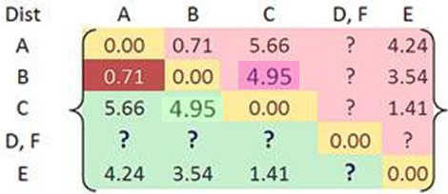
Update distance matrix (iteration 1)

Slide 21
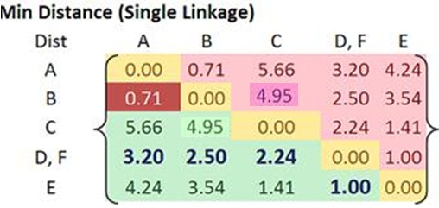
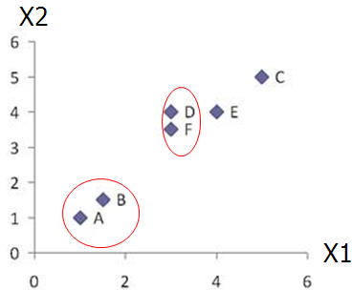
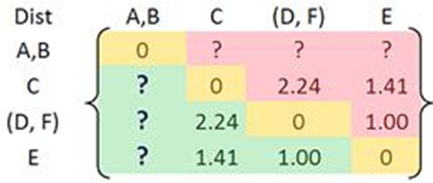
Merge two closest clusters (iteration 2)

Slide 22
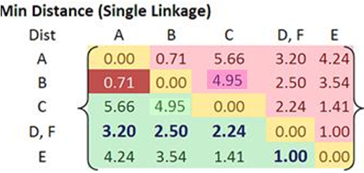
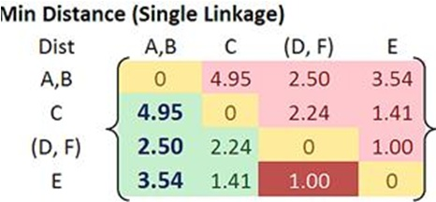

Update distance matrix (iteration 2)

Slide 23
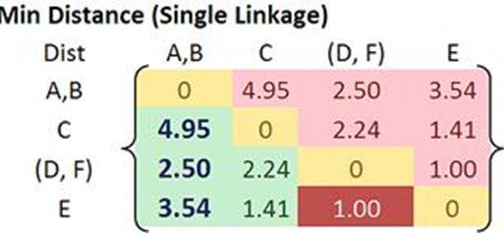
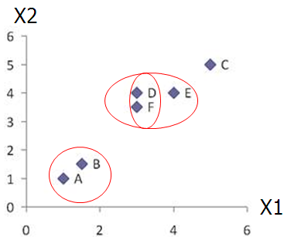
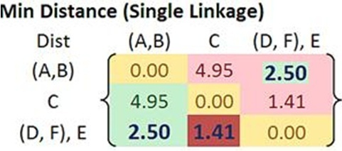

Merge two closest clusters/update distance matrix (iteration 3)

Slide 24
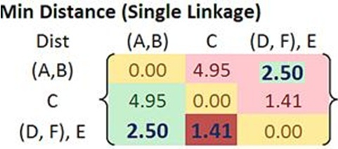
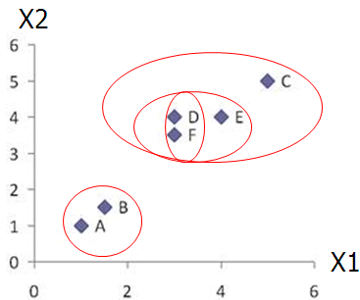
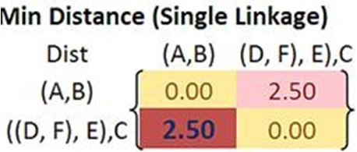

Merge two closest clusters/update distance matrix (iteration 4)

Slide 25
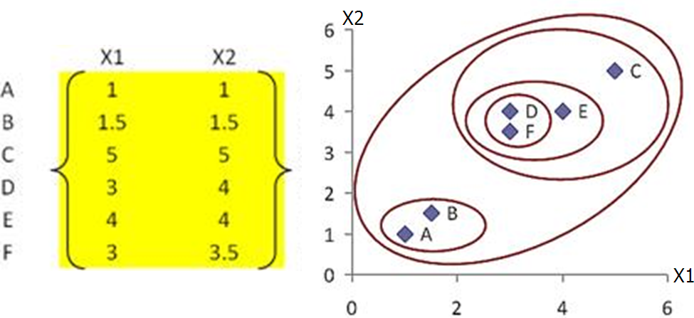
Final result (meeting termination condition)

Slide 26
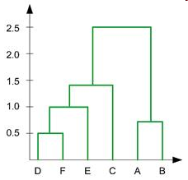
Example
Dendrogram tree representation
In the beginning we have 6
clusters: A, B, C, D, E and F
We merge clusters D and F into
cluster (D, F) at distance 0.50
We merge cluster A and cluster B
into (A, B) at distance 0.71
We merge clusters E and (D, F)
into ((D, F), E) at distance 1.00
We merge clusters ((D, F), E) and C
into (((D, F), E), C) at distance 1.41
We merge clusters (((D, F), E), C)
and (A, B) into ((((D, F), E), C), (A, B))
at distance 2.50
The last cluster contain all the objects,
thus conclude the computation
6
lifetime
5
4
3
2
object
Notes:
For a dendrogram tree, its horizontal axis indexes all objects in a given data set, while its vertical axis expresses the lifetime of all possible cluster formation.
The lifetime of a cluster in the dendrogram is defined as a distance interval from the moment that the cluster is created to the moment that it disappears by merging with other clusters.

Slide 27
Hierarchical: AGNES & DIANA

Slide 28
Contd….
Two types of Hierarchical Clustering: Agglomerative (bottom-up) and Divisive (top-down).
Agglomerative (AGNES): begin with each element as a separate cluster and merge them into successively larger clusters
Divisive (DIANA): begin with the whole set and proceed to divide it into successively smaller clusters.
Notes:
Probably the simplest clustering technique – very straightforward.

Slide 29
Contd….
Step 0
Step 1
Step 2
Step 3
Step 4
agglomerative
(AGNES)
a
a b
b
a b c d e
c
c d e
d
d e
e
divisive
(DIANA)
Step 4
Step 3
Step 2
Step 1
Step 0

Slide 30
AGNES (Agglomerative Nesting)
Agglomerative, Bottom-up approach
Initially each item in its own cluster
Iteratively clusters are merged together

Slide 31
DIANA (Divisive Analysis)
Initially all items in one cluster
Large clusters are successively divided
Top Down

